Slide 2

Navigating offtake contracts in
renewable fuel production planning
Frederik Skou Fertin
Farzaneh Pourahmadi
Ioannis Kountouris
Dogan Keles

Slide 3
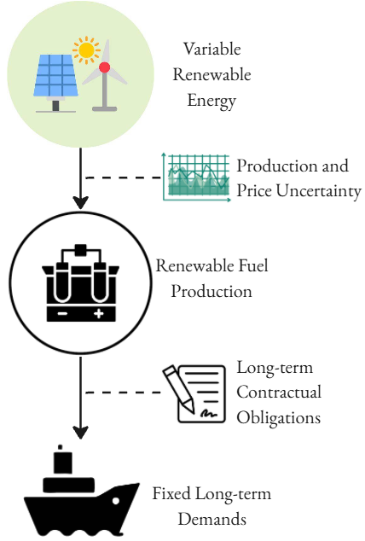
Motivation and objective
Renewable fuel (RF) production needs to operate flexibly to match variable renewable electricity.
Limited foresight in operations introduces risk in price-sensitive operations.
To enable investments, contracts are required to hedge against risks both upstream and downstream.
We focus on the navigation between price-sensitive, flexible fuel production, and meeting long-term (annually) contracted demands.
Research questions:
How can long-term contractual offtake commitments be optimally fulfilled in RF production?
What is required for an investment and operational framework to optimize contracted RF production?
How do limitations in foresight capabilities and choice of navigation strategy affect the operational earnings of RF production?
Notes:
Why do we need renewable fuels? Where is it needed? Decarbonization of hard-to-abate; shipping and aviation.
What are the challenges that renewable fuel production is facing? What are the opportunities? Stable contracted revenue with potential for extra on spot markets.
What is the tradeoff of contracting/ not contracting fuel production? How does this carry-over to financing conditions?

Slide 4
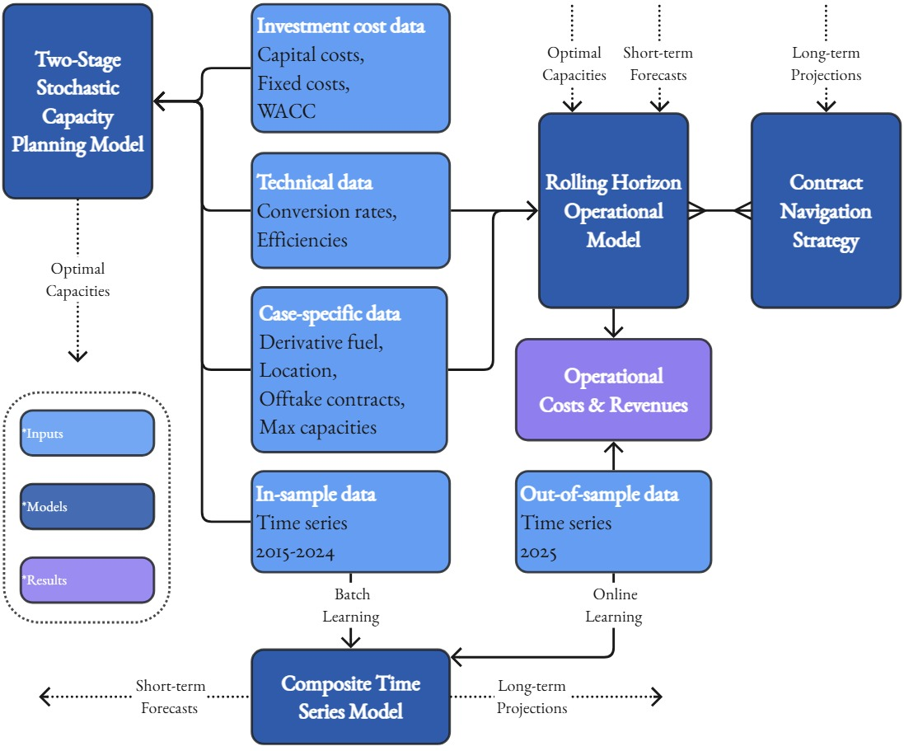
Methodology
Holistic framework – from capacity planning to daily forecasting and optimization.
Four key methodological elements
Rolling Horizon Operational Model
Mathematical model of RF production and offtake contracts.
Risk-Aware Capacity Planning Model
Composite Time Series Model
Forecasts and projects cross-correlated VRE and day-ahead market prices.
Contract Navigation Strategies
Tractable inclusion of long-term contracts in daily decision-making.
Notes:
Why do we need renewable fuels? Where is it needed? Decarbonization of hard-to-abate; shipping and aviation.
What are the challenges that renewable fuel production is facing? What are the opportunities? Stable contracted revenue with potential for extra on spot markets.
What is the tradeoff of contracting/ not contracting fuel production? How does this carry-over to financing conditions?

Slide 5
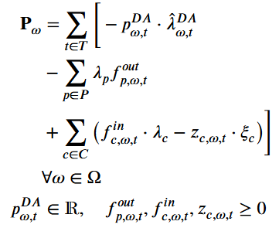

Rolling Horizon Operational Model
Day-ahead electricity costs
Subject to technical constraints on intermediary storages, conversion processes/synthesis technologies, offtaker availability (monthly docking ships).
Two revenue streams: Day-ahead electricity market and fuel production.
Navigation entails accurately identifying the value of fuel production/the opportunity cost of selling electricity.
Capacity planning model includes years of time steps and annualized capital costs.
PPA electricity costs
Fuel contract revenue & penalties
(Scenarios)
(Profit-maximizing operations)
Notes:
Why do we need renewable fuels? Where is it needed? Decarbonization of hard-to-abate; shipping and aviation.
What are the challenges that renewable fuel production is facing? What are the opportunities? Stable contracted revenue with potential for extra on spot markets.
What is the tradeoff of contracting/ not contracting fuel production? How does this carry-over to financing conditions?

Slide 6
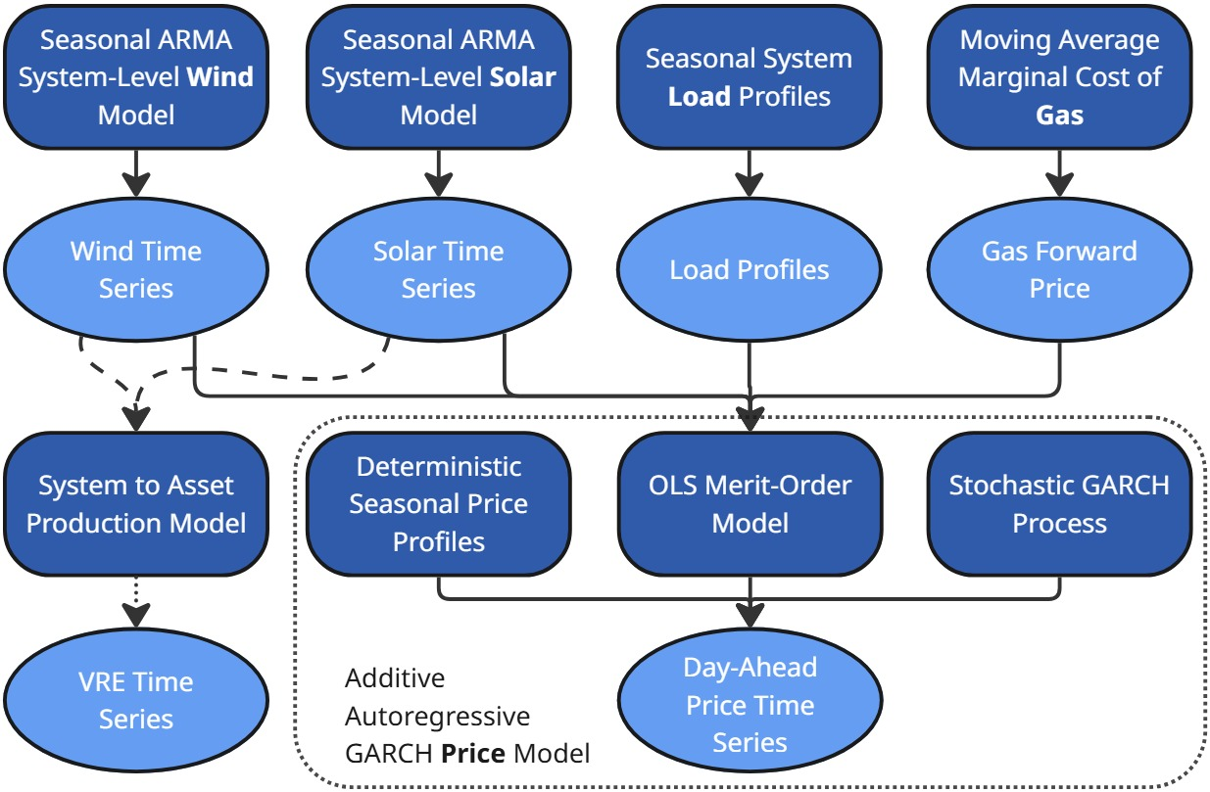
Composite Time Series Model
Forecasts and projects the uncertainties that the RF plant is facing.
Forecasts short-term (4 days) - deterministic components.
Projects long-term (year-ahead) - deterministic components and sampled stochastic processes.
Necessary element to inform Contract Navigation Strategies out-of-sample.
Notes:
Why do we need renewable fuels? Where is it needed? Decarbonization of hard-to-abate; shipping and aviation.
What are the challenges that renewable fuel production is facing? What are the opportunities? Stable contracted revenue with potential for extra on spot markets.
What is the tradeoff of contracting/ not contracting fuel production? How does this carry-over to financing conditions?

Slide 7
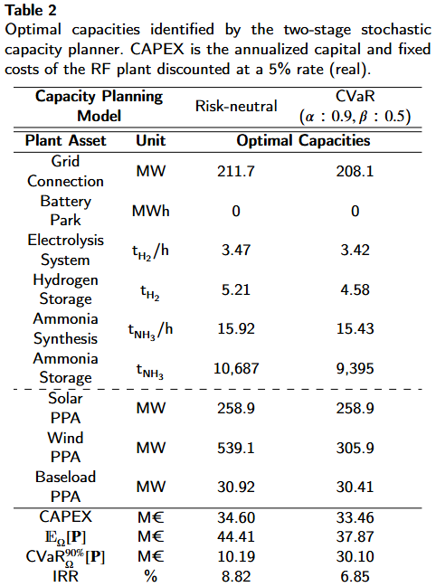
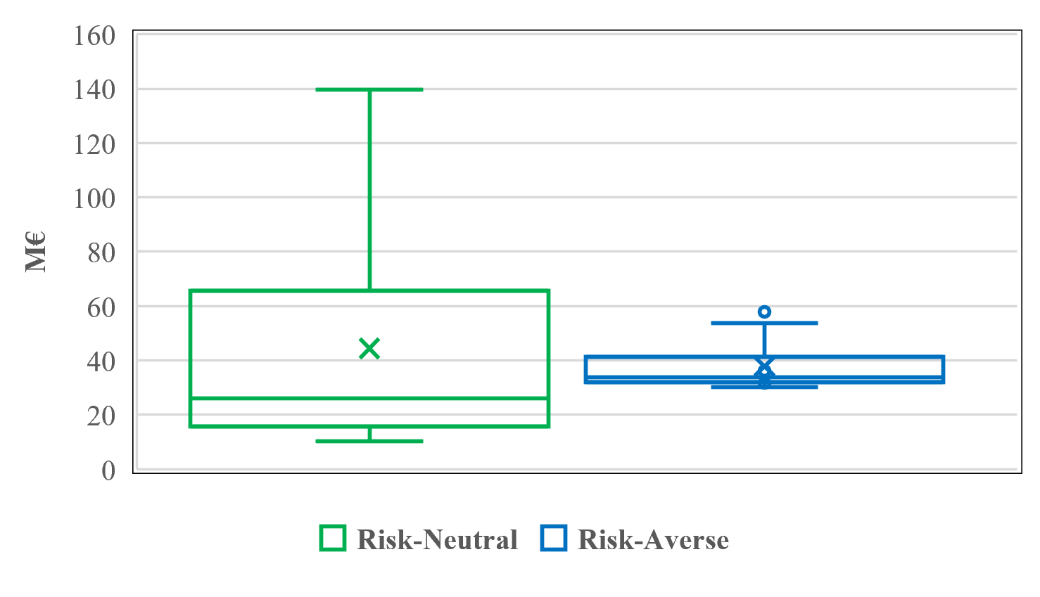
Results – Hydrogen and ammonia plant (Portugal case)
Offtake contracts:
Ammonia contract of 100 kt NH3/year.
Hydrogen contract of 0.5 t H2/hour.
Optimal capacity utilization around 70-75%.
Distribution of in-sample annual earnings of RF plant from 2015-2024.
Notes:
Mention linear mathematical model of plant. Discuss briefly simple mathematical formulation and the resulting very flexible plant.

Slide 8
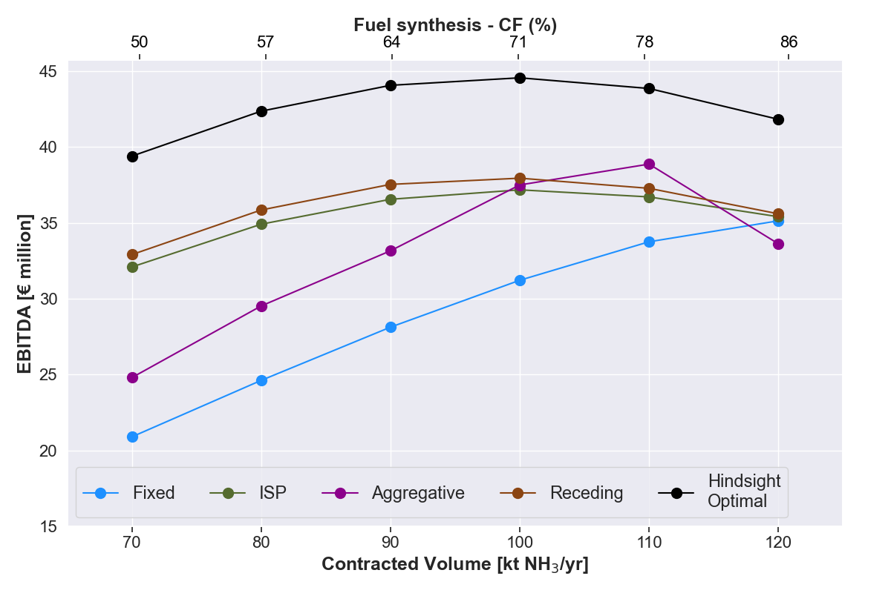
Results – 2025 out-of-sample earnings
Contract Navigation Strategies (CNS):
Fixed: Hourly fixed ammonia production.
ISP: Utilizes projections to construct forward price-duration curves, estimating opportunity cost of electricity sales.
Aggregative: Includes an aggregate time step in operational model, representing long-term operational decisions.
Receding: Constructs a full year-ahead operational model with all time steps. (Computationally heavy)
Hindsight Optimal: Earnings possible with perfect information.
Results:
CNS in the base case (100 kt) can improve earnings by €6 million from the Fixed CNS.
The identified out-of-sample optimal capacity utilization is consistent with in-sample results.
However, the Fixed CNS suggests that a non-merchant strategy can capture almost as high earnings - Amplified by a high contracted ammonia price.
The ISP CNS consistently navigates the long-term contracts satisfactory also at low contracted levels.
Notes:
Mention linear mathematical model of plant. Discuss briefly simple mathematical formulation and the resulting very flexible plant.

Slide 9
Conclusion and contributions
We contribute to the literature with a holistic framework which optimizes RF plant capacities and PPA contracts to offtake contracts.
Novel work on long-term RF contracts not limited to hydrogen systems.
We develop an operational framework, integrating time series modelling and elaborate strategies to assess realistic operational capability to capture favourable electricity market participation.
With CNS we can achieve higher earnings than through a fixed-production operational strategy – further incentivizing flexible RF production tracking variable renewables while complying with long-term offtake contracts, which is required to secure the business case.
Notes:
Mention linear mathematical model of plant. Discuss briefly simple mathematical formulation and the resulting very flexible plant.

Slide 10
Additional aspects
Investigation of robustness of CNS earnings to forecaster variance.
Base case investigation of revenue and cost distribution between CNS.
Notes:
Mention linear mathematical model of plant. Discuss briefly simple mathematical formulation and the resulting very flexible plant.

Slide 11
The two most relevant studies from the literature
Palmer et al. (2025). Hedging hydrogen: Planning and contracting under uncertainty for a green hydrogen producer.
Optimizes hydrogen production capacities under hydrogen contracts.
Tests solution out-of-sample, but assumes perfect annual foresight during dispatch.
Schrotenboer et al. (2022). A Green Hydrogen Energy System: Optimal control strategies for integrated hydrogen storage and power generation with wind energy
Navigates bi-weekly hydrogen contracts, modelling the hydrogen production as a Markov decision process.
Does not consider long-term contractual production obligations, thus not investigating the importance of long-term forecasting and scheduling of fuel production.
Does not evaluate decision policies and generated revenues out-of-sample.
Notes:
Why do we need renewable fuels? Where is it needed? Decarbonization of hard-to-abate; shipping and aviation.
What are the challenges that renewable fuel production is facing? What are the opportunities? Stable contracted revenue with potential for extra on spot markets.
What is the tradeoff of contracting/ not contracting fuel production? How does this carry-over to financing conditions?

Slide 12
Gap and research questions
There is no established methodology for modelling and integrating long-term fuel offtake commitments into the daily operational planning of a RF plant.
The presented literature does not present operational frameworks which integrate forecasting and extended contexts, creating a need for a holistic operational framework which integrates up-to-date contextual information into the operational planning of fuel production and validates the framework out-of-sample.
Research questions:
How can long-term contractual offtake commitments be optimally fulfilled in RF production?
What is required for an investment and operational framework to optimize contracted RF production?
How do limitations in foresight capabilities and choice of navigation strategy affect the operational earnings of RF production?
Notes:
Why do we need renewable fuels? Where is it needed? Decarbonization of hard-to-abate; shipping and aviation.
What are the challenges that renewable fuel production is facing? What are the opportunities? Stable contracted revenue with potential for extra on spot markets.
What is the tradeoff of contracting/ not contracting fuel production? How does this carry-over to financing conditions?

